Slide 1





What Is Lead Time?
Lead time is the amount of time that passes from the start of a process until its conclusion.. By comparing results against established benchmarks, they can determine where inefficiencies exist. Reducing your lead time can improve productivity, streamline the operations and increase output and revenue. Whereas longer lead times can negatively impact all of the above.

Slide 2


Lean Management Components
There are several components to Lean Management that affect Lead Time.
All of them need to be considered to help things run as efficiently as possible thus lowering the lead time.

Slide 3

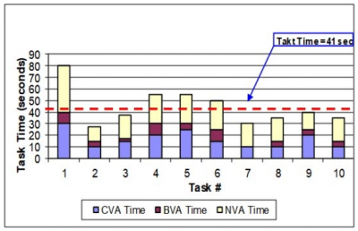
What is Processing Time
The time it takes from when an item enters a process until it exits a process is called process lead time aka PLT.

Slide 4

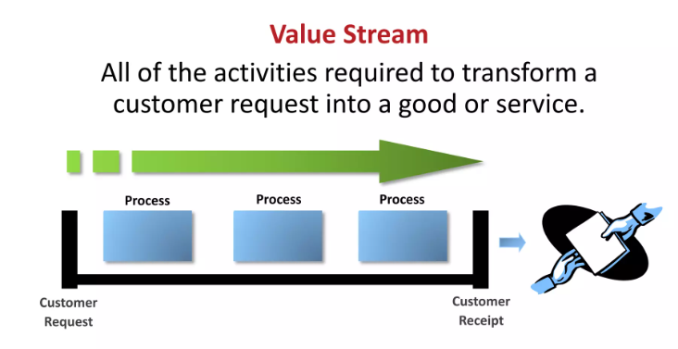
Value Stream
Measuring how long it takes to complete a process is a way to see where gaps in the process exist so they can be corrected to reduce the amount of Processing Time.

Slide 5

The Value Stream is defined as the specific activities within a supply chain required to design, order and provide a specific product or service which helps with both Lead Time and Processing Time.
What is a Value Stream…?

Slide 6


Why It Matters…
The purpose of calculating these times help in preventing the wastage of time and money. Wastage of time and money can still be reflected in papers. When it comes to time though, the wastage is not easily visible as it is not a tangible thing. The waste cannot be seen lying around on the factory floors.

Slide 7

Lead Time Vs. processing time
LEAD
VS
PROCESSING

Slide 8

Both Are Essential…
Because without taking both into account there would still less working time and more production time!!

Slide 9
WHICH ONE TO CHOOSE…
It is essential for a quality management professional to determine which of the two is adept for a project. The calculation of these times is essential for quality management projects.

Slide 10

References:
https://www.investopedia.com/terms/l/leadtime.asp US Department of State Bureau of Consular affairs.
https://www.greycampus.com/blog/quality-management/demystifying-the-difference-between-lead-time-takt-time-and-cycle-time Grey Campus Library
https://www.slideshare.net/KarenMartinGroup/lean-leadership-part-3-of-3-67838100/30-Lead_Time_vs_Process_TimeLead TKMG, Inc.

